Slide 1

DEVELOPMENT OF A SMOKING CESSATION SUPPORT SYSTEM
IE 7275 Data Mining in Engineering
Group 90
Sai Srinivas Madamraju
Sri Mahalakshmi Harika Punati
Date: 04-14-2023

Slide 2
Overview
Problem Setting
Problem Definition
Data sources
Data Description
Data Exploration
Data Mining Tasks
Data Mining Models
Performance Evaluation
Insights for decision making
Project Results and Conclusion
Impact of the project outcomes

Slide 3
Problem Setting
Smoking causes an estimated 7 million deaths annually
Major contributor to avoidable deaths and linked to heart disease, COPD, and lung cancer
Second-hand smoke also harmful to nearby individuals
Significant financial burden on society due to healthcare costs related to smoking-related illnesses
Despite available initiatives to quit smoking, many people still smoke
Need for effective interventions to help individuals quit smoking and prevent initiation in young people

Slide 4
Problem Definition
To classify smoking behaviour based on various factors
Using data mining techniques, we aim to develop a model that can classify individuals as smokers or non-smokers based on various factors such as age, gender, education level, income, etc. This classification will be based on patterns and relationships identified in the data.
To aid in the development of targeted intervention programs to help individuals quit smoking and reduce health risks
By identifying the factors that are most strongly associated with smoking behaviour, we hope to provide insights that can be used to develop targeted intervention programs. These programs can be tailored to the needs of specific groups or individuals and can help promote smoking cessation and reduce the associated health risks.
Expected Outcome
The main outcome of this project is to provide insights into the factors that influence smoking behaviour and contribute to the development of effective smoking cessation programs. By achieving our objectives, we hope to make a meaningful contribution to the field of public health and help reduce the burden of smoking-related illnesses

Slide 5
Data Source
Development of a smoking cessation support system data set has been taken from smoker status prediction dataset using Kaggle datasets
https://www.kaggle.com/datasets/gauravduttakiit/smoker-status-prediction

Slide 6
Data Description
38,985 rows and 23 columns
5 categorical variables
18 numerical variables

Slide 7
Data Exploration
Data understanding: The original dataset contains 38983 instances, with 22 parameters and one target variable named "Smoking". The dataset comprises 4 categorical variables and 18 numeric variables.
Data preprocessing: Since there are no missing values, null values, or inconsistencies in the dataset, and the data is already in a standard format, further tasks can be carried out using the same dataset.

Slide 8
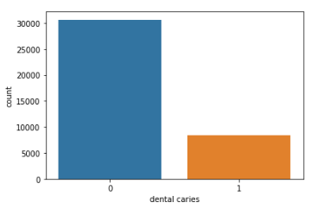
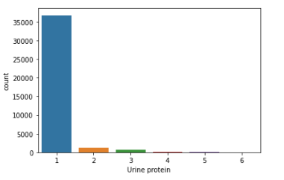
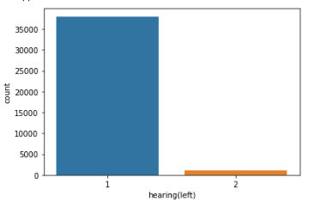
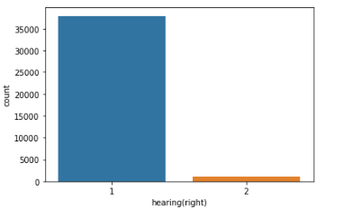
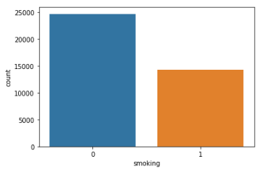
Categorical Variables
Dental Caries
Urine Protein
Hearing(Left)
Hearing(Right)
Smoking

Slide 9
Chi-Square test for correlation analysis of categorical variables
1.Null hypothesis H0: The variable has no correlation 2. Alternate hypothesis H1: The variable has a correlation
If the resulting p-value from the test is greater than 0.05 it is concluded that the variables are correlated. The chi-Square test is performed between target categorical variable ‘Smoking’ and other categorical variables.
Results:
All the categorical variables are correlated to target variable.

Slide 10
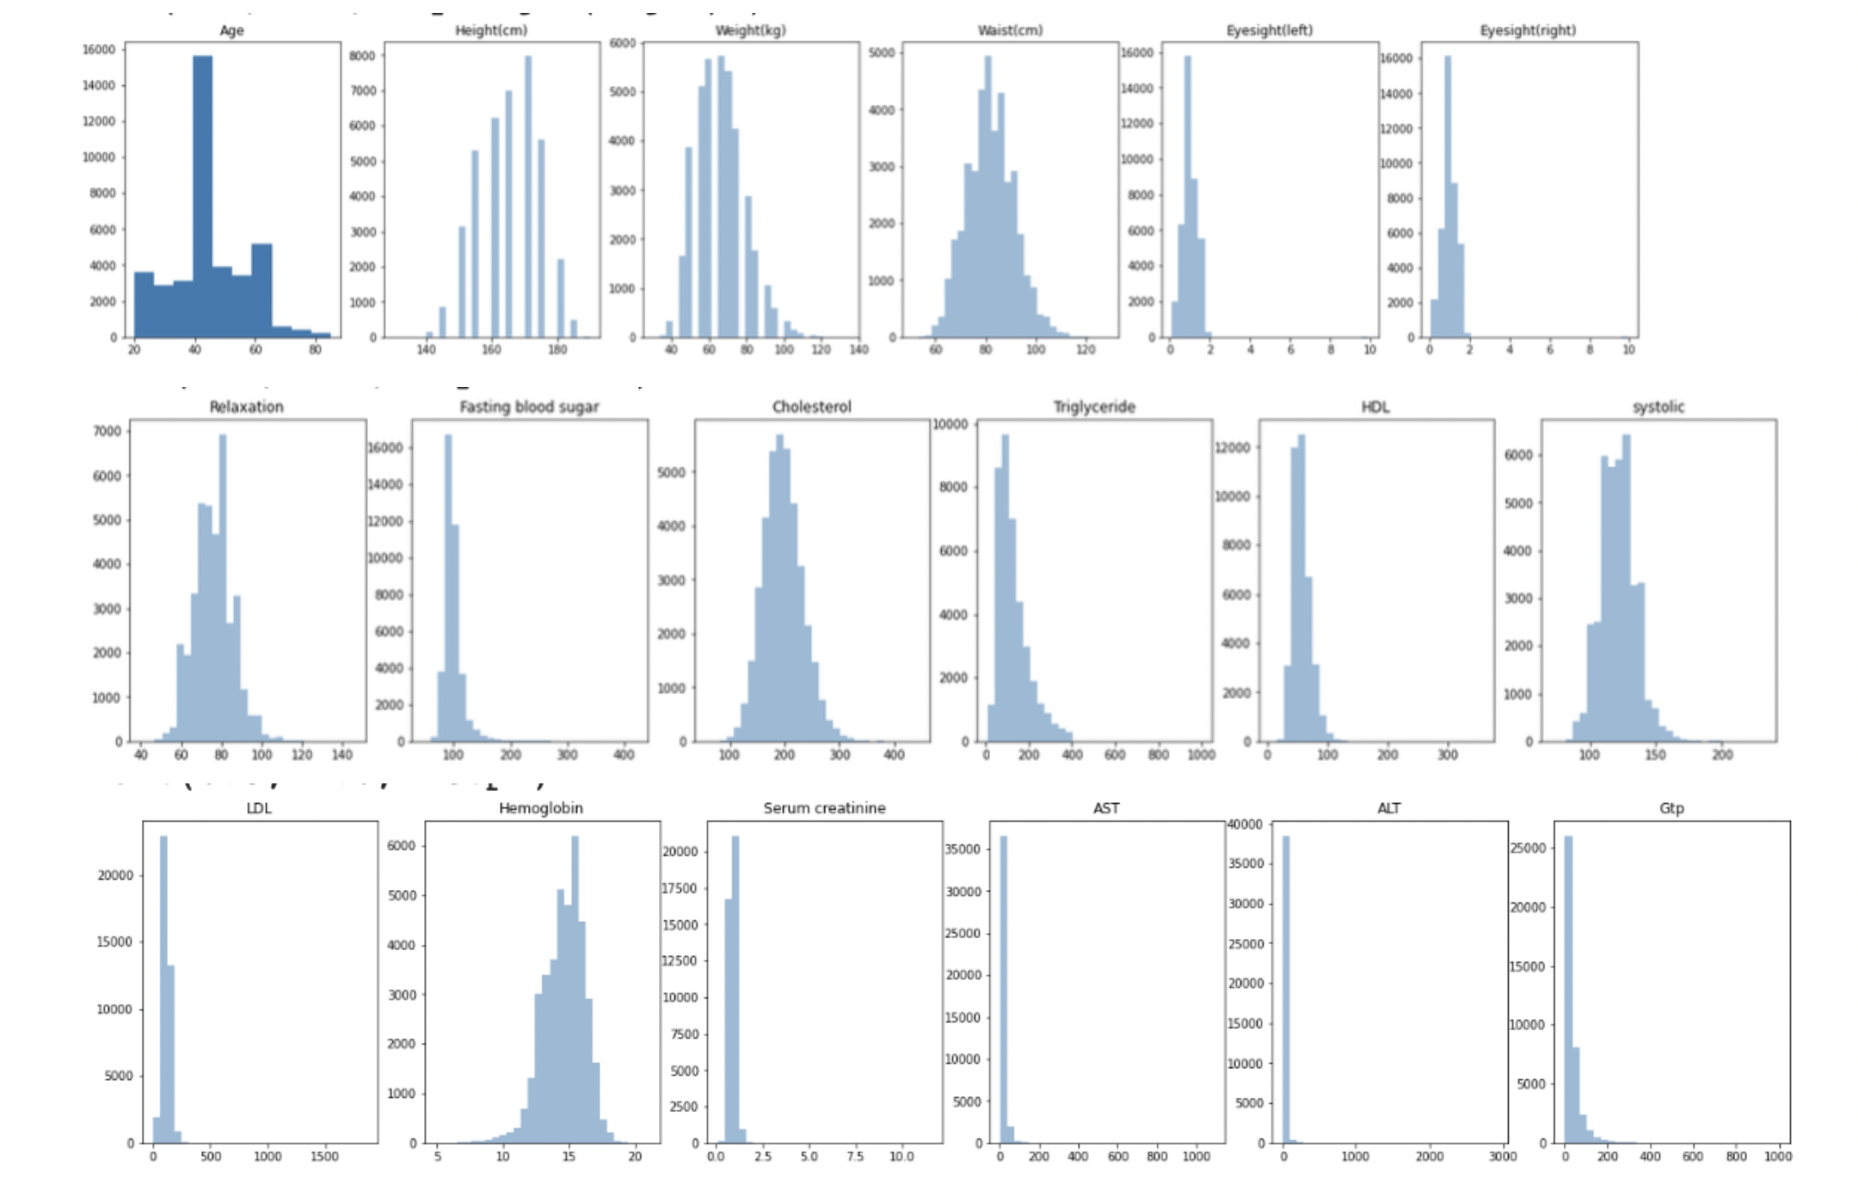
Numeric Variables: Numeric variables are represented using histograms. These are the numeric plots before removing outliers.

Slide 11
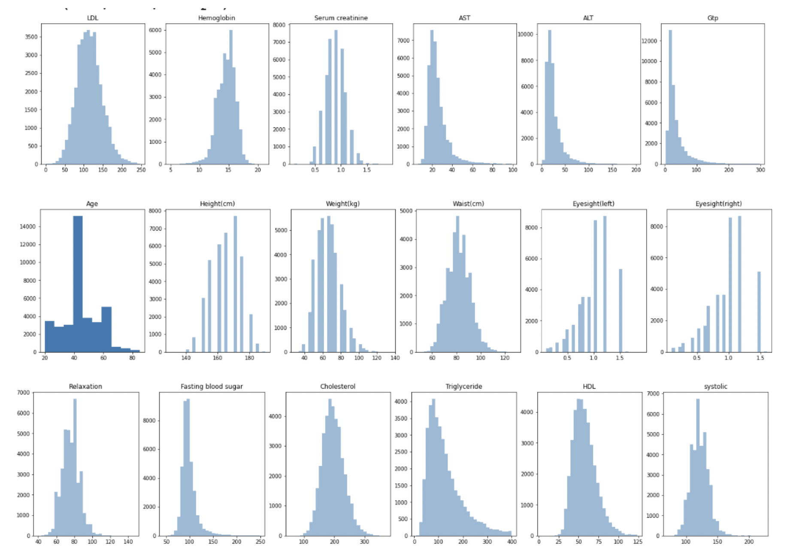
Numeric variables are represented using histograms. These are the numeric plots after removing outliers and duplicates. After removing 5,362 duplicates and 1,171 outliers, the new data set has 32,451 rows

Slide 12
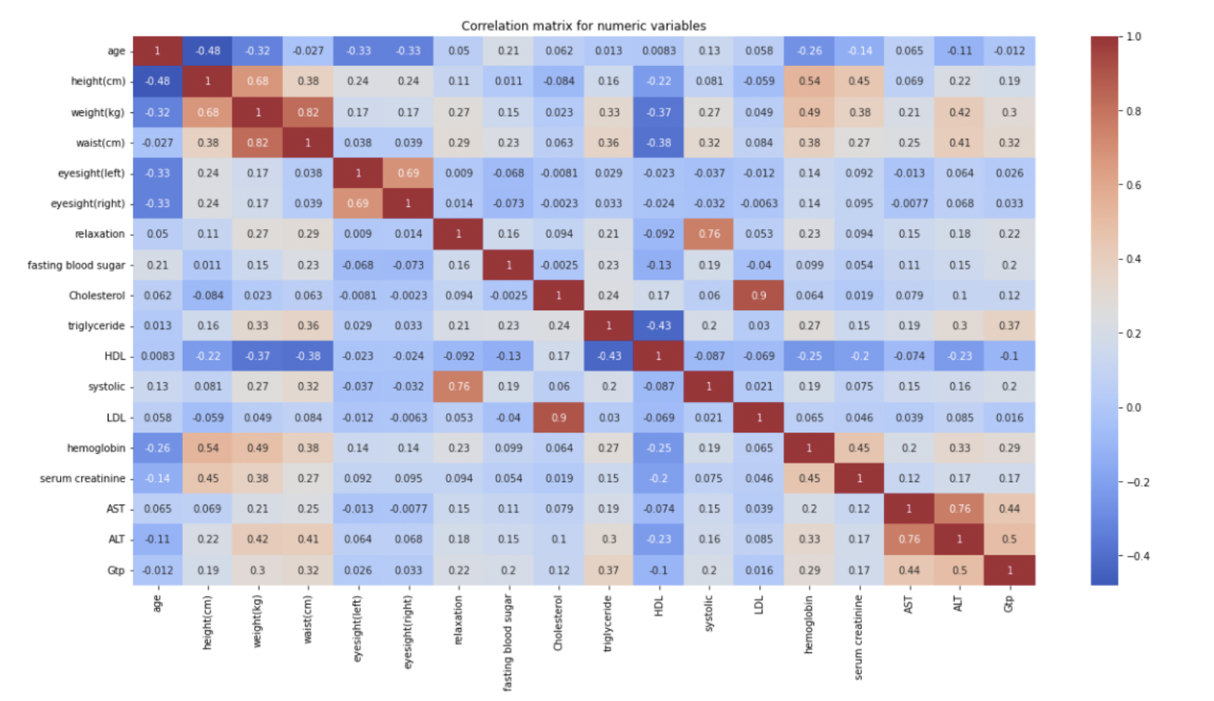
Correlation analysis of numeric variables using Pearson’s correlation

Slide 13
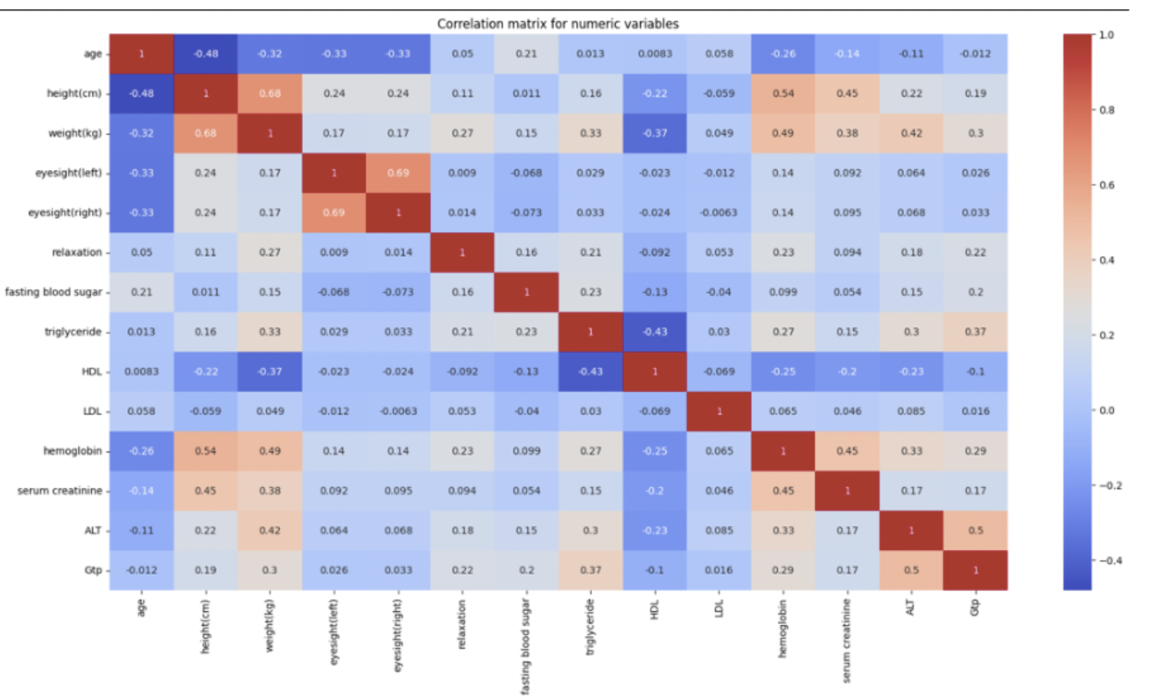
Correlation analysis of numeric variables after removing highly correlated variables

Slide 14
Point Biserial test for correlation analysis of numeric and categorical target variable
1.Null hypothesis H0: The variable has no correlation 2. Alternate hypothesis H1: The variable has a correlation
If the resulting p-value from the test is greater than 0.05 it is concluded that the variables are correlated. The Point Biserial test is performed between target categorical variable ‘Smoking’ and other numerical variables.
Results:
All the numeric variables are correlated to target variable.

Slide 15
Data Mining Tasks
Target variable: "Smoking” (represented by "y")
Predictor variables: represented by "X"
Dataset split: 80:20 ratio for training and testing
Predictor Train set: 33,121 records and 18 variables
Target Train set: 33,121 records and 1 variable
Predictor Test set: 8,281 records and 18 variables
Target Test set: 8,281 records and 1 variable

Slide 16
Data Mining Methods
K-NN classifier:
K-NN classification algorithm categorizes new records by comparing them to comparable records in the training data
Majority decision rule is used to categorize new records as a member of the majority class of the K-neighbours
Nearest K-NN classifier was used with K=3
Different weight and distance metrics were used to find the ideal value of K
Weight metrics: Distance
Distance metrics: Euclidean
Accuracy of the model is 76.4%

Slide 17
Data Mining Methods
Decision Tree classifier:
Utilizes a tree-like model to predict outcomes.
Splits predictors to produce logical rules and increase homogeneity.
The model was built with min_samples_split=5.
Accuracy of the model is 74%

Slide 18
Data Mining Methods
Logistic Regression classifier:
Logistic regression is a parametric classification model that produces a categorical outcome variable.
It models the likelihood of being assigned to either of the classes using a logit outcome variable.
The logit outcome variable can be considered as a linear function of the predictors.
The logistic regression model was built.
The accuracy of the model is 71.2%.

Slide 19
Data Mining Methods
Random Forest classifier:
Random Forest is an ensemble method that uses multiple decision trees to make predictions.
Each tree is trained on a random subset of features and observations, which helps prevent overfitting.
The predictions of all the trees are combined to produce the final prediction.
The model was built with n_estimators = 100.
The model achieved an accuracy of 81% on the test set.

Slide 20
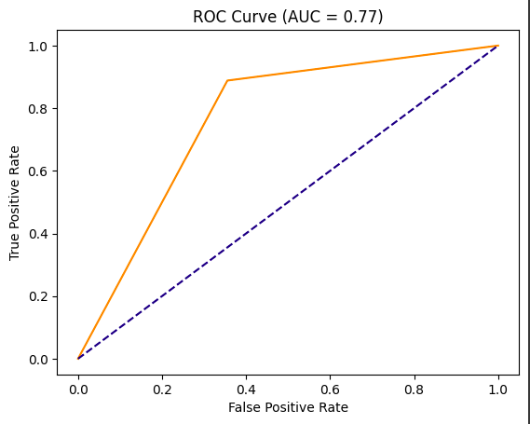
PERFORMANCE EVALUATION
K-NN Classifier
Accuracy: 76.4%
F1 score: 78.8%
Sensitivity: 88.8%
Specificity: 64.4%

Slide 21
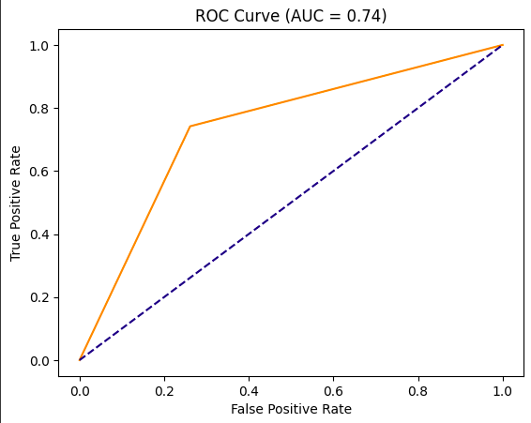
PERFORMANCE EVALUATION
Decision Tree Classifier
Accuracy: 74.0%
F1 score: 73.8%
Sensitivity: 74.1%
Specificity: 73.8%

Slide 22
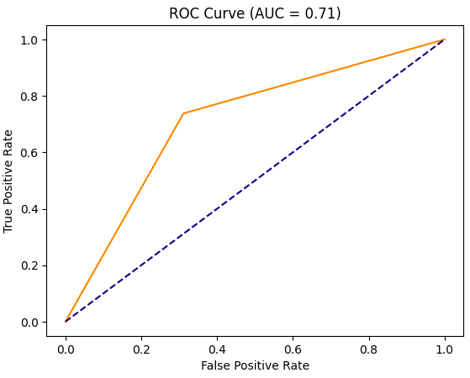
PERFORMANCE EVALUATION
Logistic Regression
Accuracy: 71.2%
F1 score: 71.7%
Sensitivity: 73.7%
Specificity: 68.8%

Slide 23
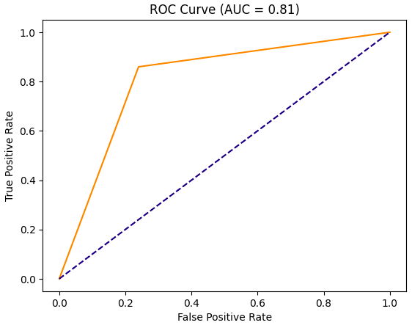
PERFORMANCE EVALUATION
Random Forest
Accuracy: 80.9%
F1 score: 81.6%
Sensitivity: 85.9%
Specificity: 76.0%

Slide 24
Insights for Decision Making
Model | Accuracy | F1 Score | Sensitivity | Specificity
K-NN Classifier | 76.4% | 78.8% | 88.8% | 64.4%
Decision Tree Classifier | 74.0% | 73.8% | 74.1% | 73.8%
Logistic Regression | 71.2% | 71.7% | 73.7% | 68.8%
Random Forest | 80.9% | 81.6% | 85.9% | 76.0%

Slide 25
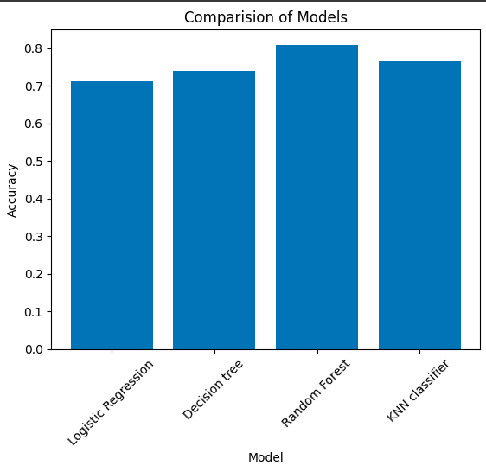
Project Results and Conclusion
Random forest model has highest accuracy of 81% compared to other models
Sensitivity: 85.9%
Specificity: 76%
F1 score: 81.6%
Random forest model outperforms other models in all metrics

Slide 26
Impact of the Project Outcomes
Random Forest model outperformed all other models with high accuracy, sensitivity, specificity, and F1 values.
Accurately identifying smoking status is important for effective treatment plans.
Random Forest model can assist healthcare professionals in identifying smokers and provide targeted interventions to help them quit smoking.
High model performance attributed to the ability of the algorithm to handle complex relationships between features.
Success of project in identifying smoking status has significant implications for reducing smoking prevalence and improving overall health outcomes.

Slide 27

Thank You

